Slide 1
Computer ARCHITECTURE (CA)
Course Instructor
Hira beenish
Department of Computer Science

Slide 2
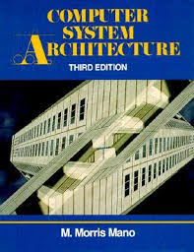
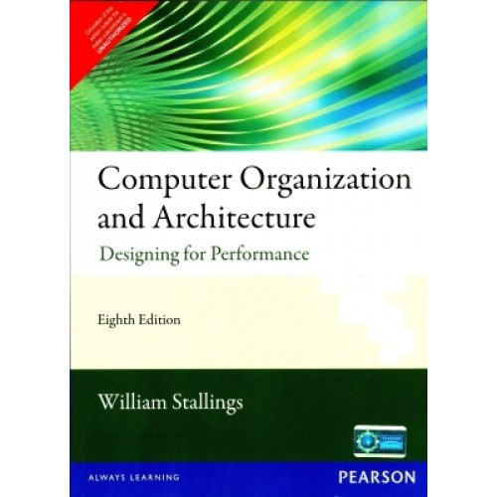
Recommended Books
Computer Systems Architecture, 3rd Edition
By M.Morris Mano; Prentice Hall International
Computer Organization and Architecture Designing For Performance By William Stallings

Slide 3
Chapters Included
1. Digital logic circuits
2. Digital components
3. Data Representation
4. Basic Computer Organization & Design →→Mid Term
5. Central processing unit
6.Pilpeline & vector processing
7. Computer arithmetic
8. I/O & O/P organization
9. Memory organization
10. Multiprocessors

Slide 4
Chapter#4 Basic Computer Organization & Design

Slide 5
Contents
Instruction codes
Computer registers
Computer instructions
Instruction cycle
common bus system
Timing & Control

Slide 6
Instruction codes
A computer instruction is a binary code that specifies a sequence of micro-operations for the computer.
Each computer has its unique instruction set
Instruction codes and data are stored in memory
The computer reads each instruction from memory and places it in a control register
The user of a computer can control the process by means of a program
A Program is a set of instructions that specify the operations, operands, and the processing sequence
An Instruction code is a group of bits that instructs the computer to perform a specific operation

Slide 7
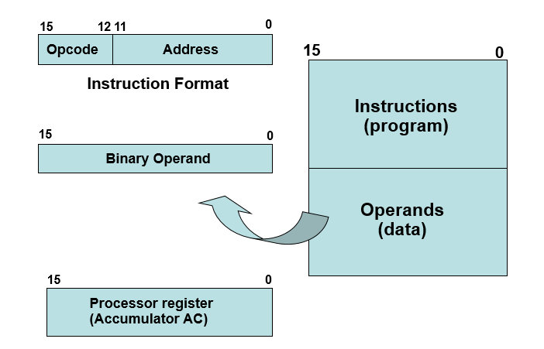
Instruction codes
It is divided into two parts
Operation code
Operand address

Slide 8
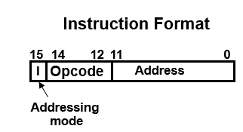
Instruction codes
A computer instruction is often divided into two parts
An opcode (Operation Code) that specifies the operation for that instruction
An address that specifies the registers and/or locations in memory to use for that operation
It consists of a 3-bit operation code
12-bit address, and an indirect address mode bit designated by I.

Slide 9
Instruction Codes
There are three Addressing Modes used for address portion of the instruction code:
Immediate: the operand is given in the address portion (constant)
Direct: the address points to the operand stored in the memory
Indirect: the address points to the pointer (another address) stored in the memory that references the operand in memory
One bit of the instruction code can be used to distinguish between direct & indirect addresses

Slide 10
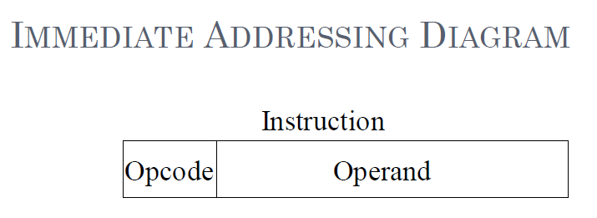
IMMEDIATE ADDRESSING
Operand is part of instruction
Operand = address field
e.g. ADD 5
Add 5 to contents of accumulator
5 is operand
No memory reference to fetch data
Fast
Limited range

Slide 11
DIRECT ADDRESSING
Address field contains address of operand
e.g. add a
Add contents of cell a to accumulator
Look in memory at address a for operand
Single memory reference to access data
No additional calculations to work out effective address
Limited address space

Slide 12
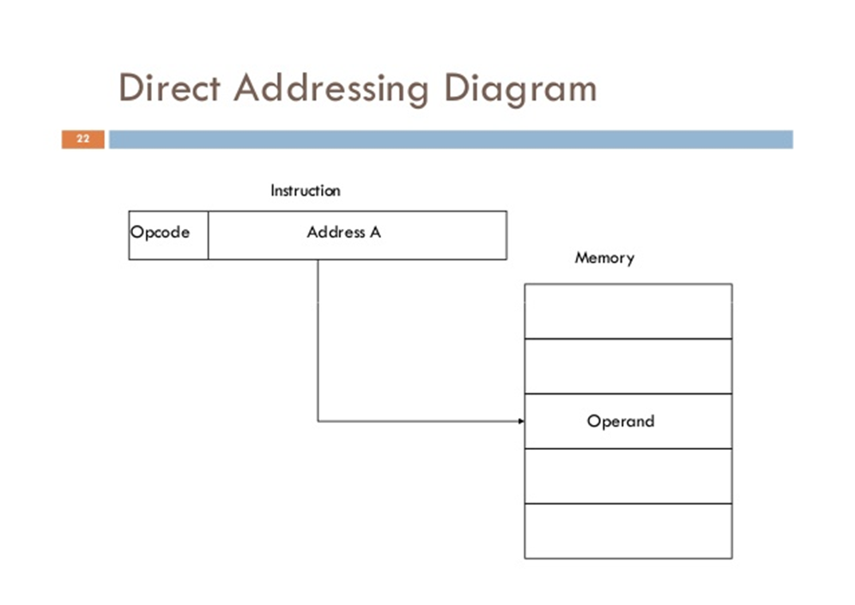

Slide 13
INDIRECT ADDRESSING
Memory cell pointed to by address field contains the address of (pointer to) the operand
EA = (a)
Look in a, find address (a) and look there for operand
e.g. add (a)
Add contents of cell pointed to by contents of a to accumulator

Slide 14
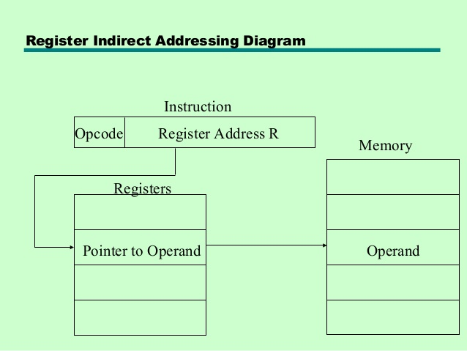

Slide 15
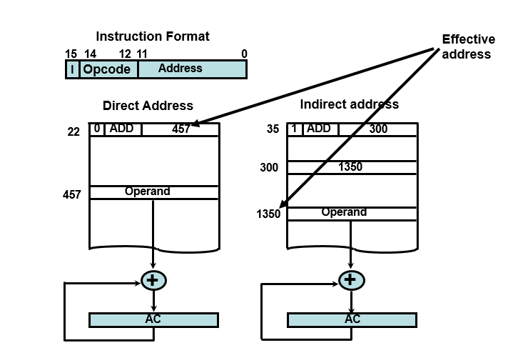
Instruction Codes Address

Slide 16
Computer Registers
Computer instructions are normally stored in consecutive memory locations and executed sequentially one at a time
The control reads an instruction from a specific address in memory and executes it, and so on
It is also necessary to provide a register in the control unit for storing the instruction code after it is read from memory

Slide 17
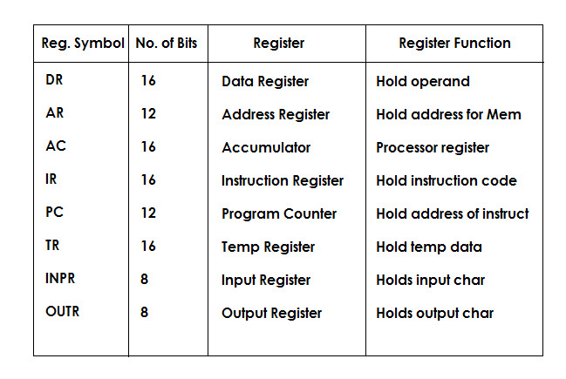
List of BC Registers

Slide 18
COMMON BUS SYSTEM
The registers in the Basic Computer are connected using a bus
This gives a savings in circuitry over complete connections between registers

Slide 19
Timing & Control
The timing for all registers in the basic computer is controlled by a master clock generator
The clock pulses are applied to all flip-flops and registers in the system, including the flip-flops and registers in the control unit
The clock pulses do not change the state of a register unless the register is enabled by a control signal
The control signals are generated in the control unit and provide control inputs for the multiplexers in the common bus, control inputs in processor registers, and micro operations for the accumulator

Slide 20
Instruction Cycle
A program is a sequence of instructions stored in memory
The program is executed in the computer by going through a cycle for each instruction (in most cases)
Each instruction in turn is subdivided into a sequence of sub-cycles

Slide 21
Instruction Cycle
Instruction Cycle Phases:
1- Fetch an instruction from memory
2- Decode the instruction
3- Read the effective address from memory if the instruction has an indirect address
4- Execute the instruction
This cycle repeats indefinitely unless a HALT instruction is encountered
Therefore whenever there is no instruction to execute by the processor, it is put in the HALT state by a HALT instruction issued by the operating system.

Slide 22
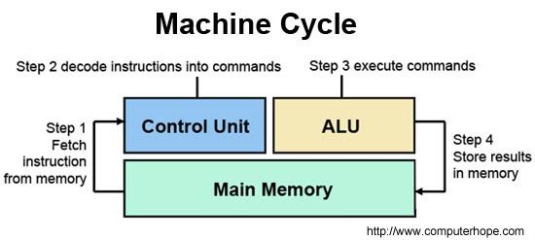

Slide 23
Thank you

